Slide 1
Agile Project Monitoring and Control
Lecturer: Ngo Huy Bien
Software Engineering Department
Faculty of Information Technology
VNUHCM - University of Science
Ho Chi Minh City, Vietnam
nhbien@fit.hcmus.edu.vn

Slide 2

Objectives
To monitor and control project.
To report project status
To evaluate project results
To evaluate team productivity

Slide 3

Contents
Stand-up meetings
Weekly demo
Burn down chart
Updated product backlog
Updated release plan
Project status report
Deliverables

Slide 4

References
James Shore and Shane Warden (2008). The Art of Agile Development. O'Reilly.

Slide 5
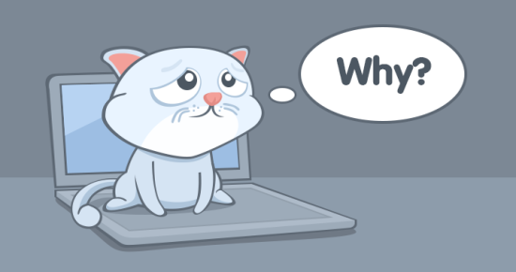
Why Do Projects Fail?
Unclear requirements (no problems, no business/user requirements, no communication with clients/users)
No executive summary, no project vision and scope
No stories/use cases, no mockups, no prototypes
Human factors
No feedback → No working together
No money, no challenges, no interesting works → No motivation
No estimation or incorrect estimation
Effort/Duration/Cost/Resources
No planning
No project schedule/release plan
No status reporting or incorrect status reporting
No project schedule/release plan updates
No risk management

Slide 6

How is Your Project Going?

Slide 7

Communication: Discussion Questions
When will your project be finished? 22/9/2021?, 3/2/2024?.
How much will be your project final cost? $1200?, $8000?.
How much work is left? 10%?, 20%?, 33%?
How much budget is left? $70,000
Status?: On Track?, Late?, Early?
How much is your team's productivity?
How much is your team member's productivity?

Slide 8

Learning at Home
Scrum
Read slides
→ Focus on estimation, release planning, and burn down chart.
→ Prepare slides and artifacts based on your project.
→ Make a presentation.

Slide 9
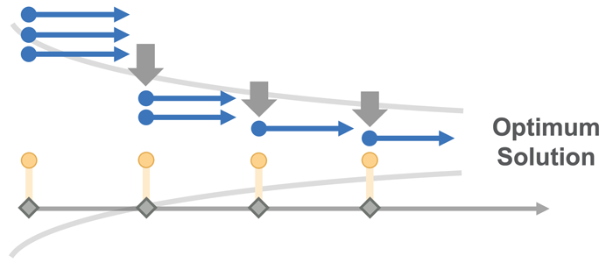
1. Create Project Timeline
Establish the timeline for deliverables for each phase of the project.

Slide 10
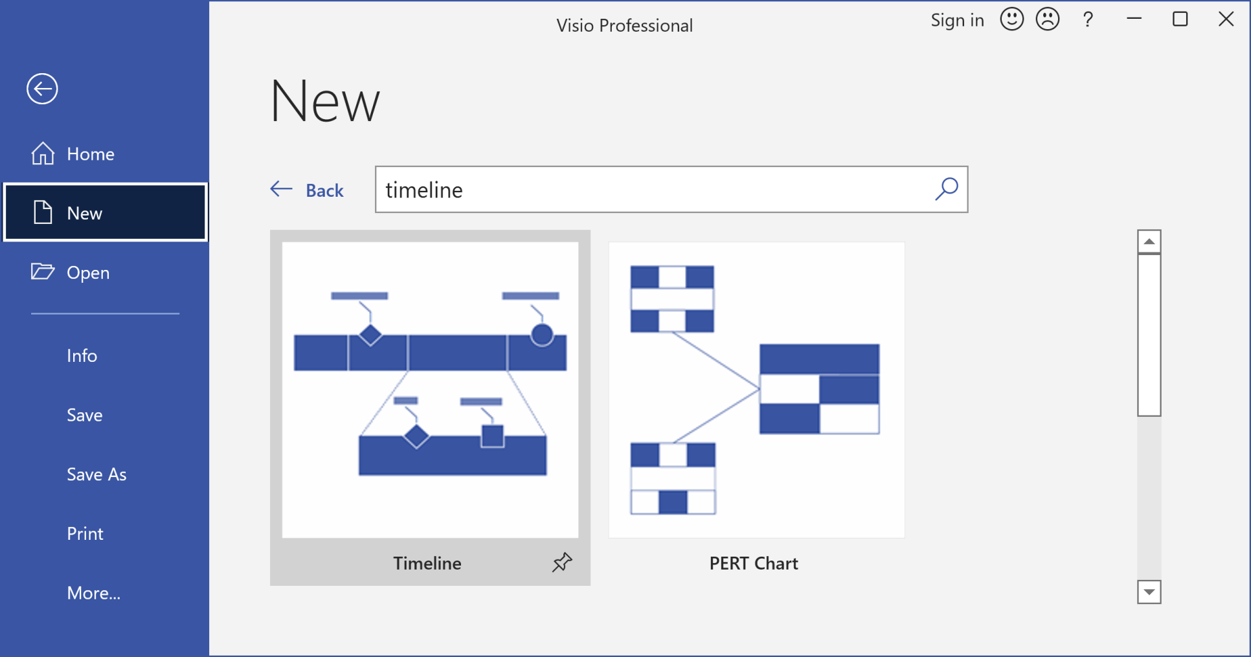
Create a Timeline in Visio
https://www.microsoft.com/en-us/microsoft-365/visio/flowchart-software

Slide 11
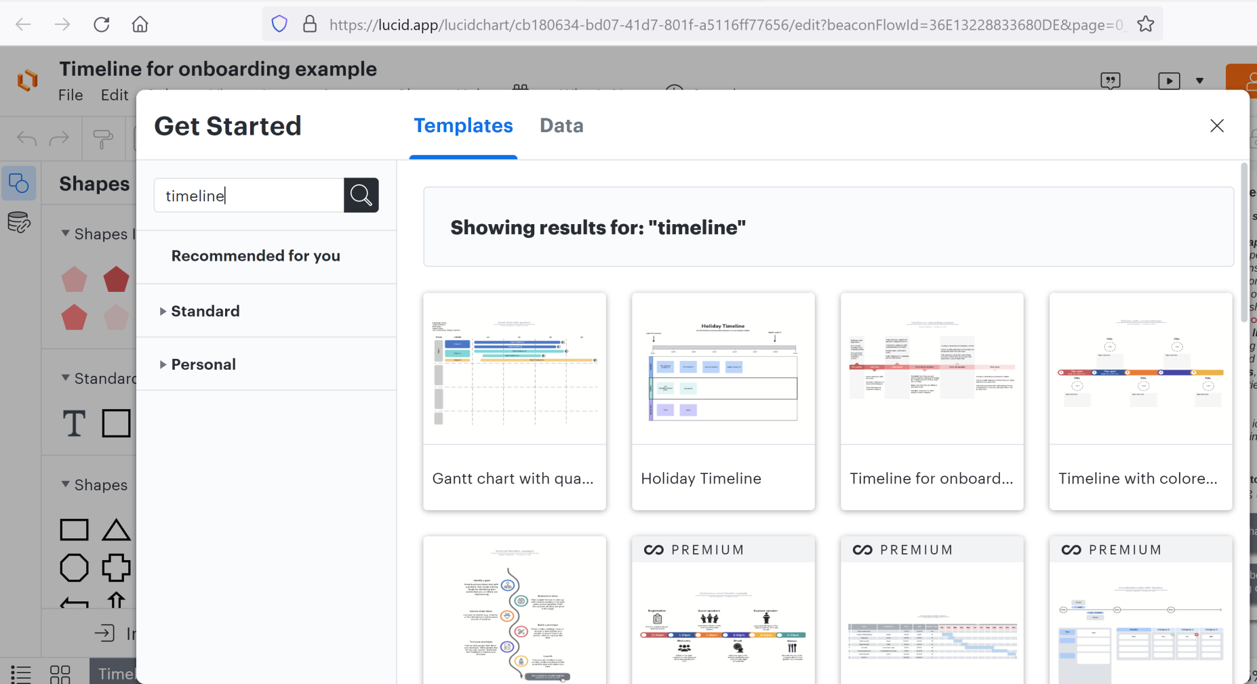
Create a Timeline in Lucidchart
https://lucid.app

Slide 12
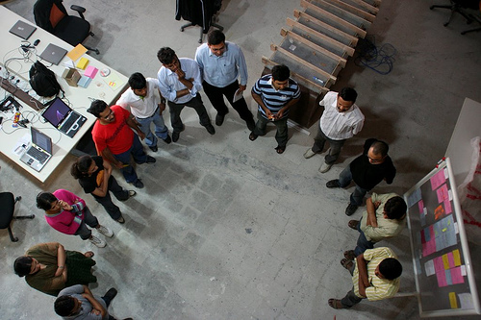
2. Conduct Stand-Up Meetings [1]
What did I do yesterday?
What will I do today?
What problems are preventing me from making progress?

Slide 13

When Things Go Wrong
Would using some of your
iteration slack help?
Is there an engineering task that
you can simplify or postpone?
Reduce the scope: split or remove a story.
Always stay in control of your iteration, even if you have to change your plan to do so.
Any iteration that delivers all of the stories in the current plan—even if you changed the plan—is a success.
Under no circumstances, however, should you change the iteration deadline.

Slide 14

An Environment of Equality
The lesser skilled developers should be able to bring ideas and changes to the team which may actually be valuable.
There's no I in Team. Leave no man behind.

Slide 15

Making Decisions
“I'm going to use NodeJS.”
“Where are your unit tests?”
Don't assume you know best for your team, even if you actually do.
Explain WHY it's the right way we should follow with technical justifications.

Slide 16

Understudy
Let people do what they're good at, but not to the extent where they are the only one who knows what's going on with that particular area.

Slide 17
This slide is intentionally left blank.

Slide 18

Don't Get Protective Over Code
Once you write code and check it in to source control, it's no longer 'your' code, it's the team’s.
Any team member has the right to change any of the team’s code.
Under NO circumstances should you arbitrarily change it back without a discussion.

Slide 19

Technical No-No's
Don't do partial check-ins.
Run all unit tests before checking in.
Don't change foundational technology or source code structure without discussion.
Don't add new technology dependencies to source code without discussion.
Nothing you do should ever stop other developers from working.
Don't make anyone’s life difficult.

Slide 20


Slide 21

When to Report?
Scrum: Daily stand-up meeting, end of a sprint.
Kanban: Duration (latest 3 weeks).

Slide 22
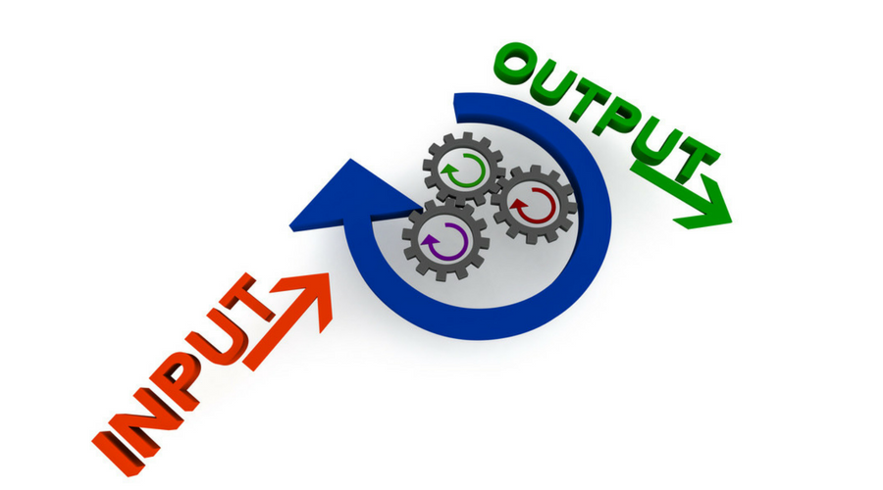
What are the Inputs?
Trello/Jira → Items completed. Process demonstration?
Scrum/Kanban
Product backlog (Updated for 9th week),
Release plan (Product Backlog + Date → Releases/Milestones) (Updated for 9th week)

Slide 23
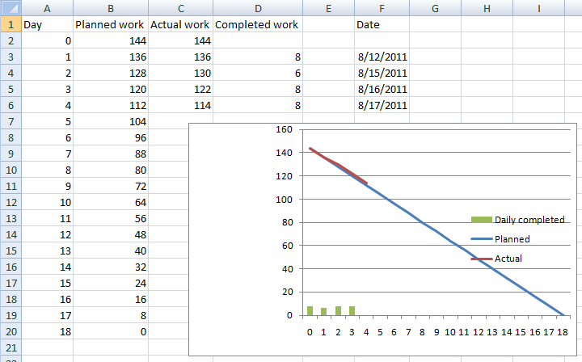
3. Create Burn Down Chart
A burn down chart is graphical representation of work left to do versus time.

Slide 24
https://screenful.com/

Slide 25

4. Perform Weekly Demo [1]

Slide 26
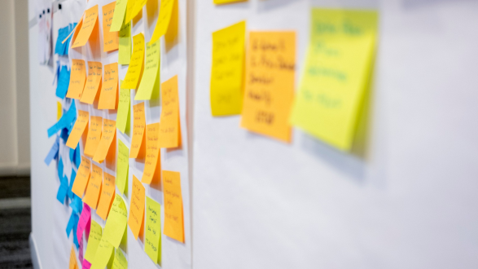
5. Manage Changes
Scrum
Warning: Start → End with no changes
→ RUP: Iterations = Sprints
Adapt to changes.
Product Owner → Product backlog → Backlog grooming
Enough analysis, documentation and design
→ Early release → Business value → Solving problem

Slide 27
6. Update Release Plan
Product Release 1 (10/04/2021)
F1
Product Release 2 (11/29/2021)
Product Release 3 (12/27/2021)
F2
F3
F6
F7
F10
F11
F12
F4
F5
F8
F9

Slide 28

7. Create Status Report
Completion scope (Percent completed): 30%?, 50%?
→ Completed points / Total points.
Completion date: ? → Total points / Velocity = # Sprints.
Budget usage? Estimated final cost?
Issues and resolutions.
Changes and impacts.
Updated product backlog.
→ A list of the stories completed.
→ Stories added or removed.
Updated release plan.
Risks with high probability and impact.
Working software and documentation.
Status Email

Slide 29

Management Reports to Consider
Productivity
Throughput
Throughput is the number of features the team can develop in a particular amount of time.
Defects
Time usage

Slide 30

Reports to Avoid
Source lines of code (SLOC) and function points
Reporting SLOC encourages defects and high costs.
Number of stories
Velocity
Never compare velocity across teams.
Code quality (cyclomatic code complexity)
They are a useful tool for developers but they’re too ambiguous for reporting to stakeholders.

Slide 31

Reporting Guidelines
Appropriate reporting will help
stakeholders trust that your team is doing good work.
Over time, the need for reports will decrease,
and you will be able to report less information less frequently.
Time spent on reports is time not spent developing.
Technically speaking, reports are wasteful because they don’t contribute to development progress.
To avoid creating reports manually, use the iteration demo, planning boards, and the burn-up chart as only reports whenever possible.

Slide 32

Thank You & See You Again

